Slide 1
Case Study Parallel Sorting
Cheng-Hung Lin

Slide 2
Parallel Sorting Algorithms
Quicksort
Quicksort with openmp

Slide 3
qsort
C provides an implementation of quicksort. The prototype is
void qsort ( void *base, size_t count, size_t size,
int (*compar)(const void *element1, const void *element2) );
qsort sorts an array whose first element is pointed to by base and contains count elements, of the given size.
The function compare returns
−1 if element1 < element2,
0 if element1 = element2,
+1 if element1 > element2.
We will apply qsort to sort a random sequence of doubles.

Slide 4
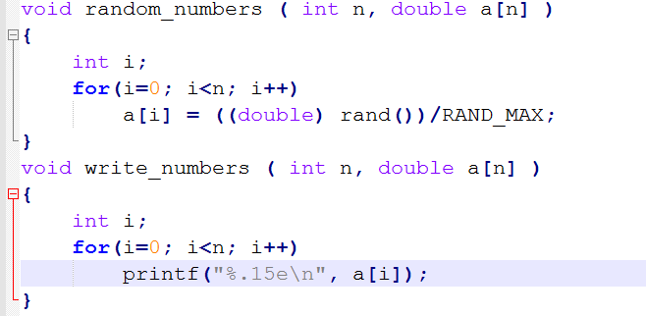
Generating and writing numbers

Slide 5
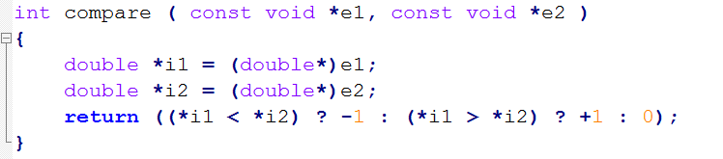
compare

Slide 6
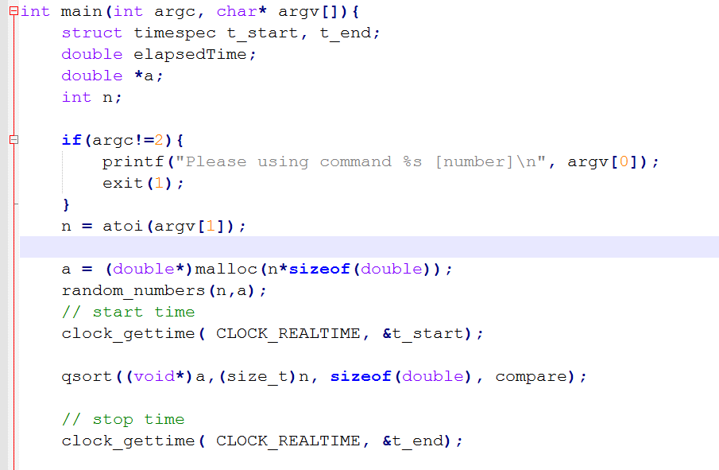

Slide 7
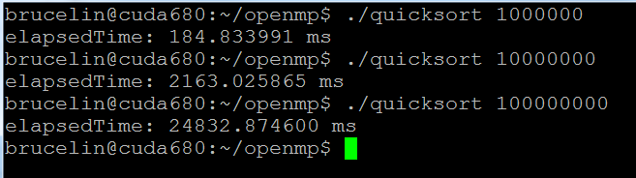
Timing qsort
Observe: O(n log2 (n)) is almost linear in n

Slide 8
Quicksort for shared memory
a recursive algorithm
void quicksort ( double *v, int start, int end ) {
if(start < end) {
int pivot;
partition(v, start, end, &pivot);
quicksort(v,start,pivot-1);
quicksort(v,pivot+1,end);
}
}

Slide 9
Partition algorithm
void partition ( double *v, int lower, int upper, int *pivot );
/* precondition: upper - lower > 0
*takes v[lower] as pivot and interchanges elements:
* v[i] <= v[pivot] for all i < pivot, and
* v[i] > v[pivot] for all i > pivot,
* where lower <= pivot <= upper. */

Slide 10
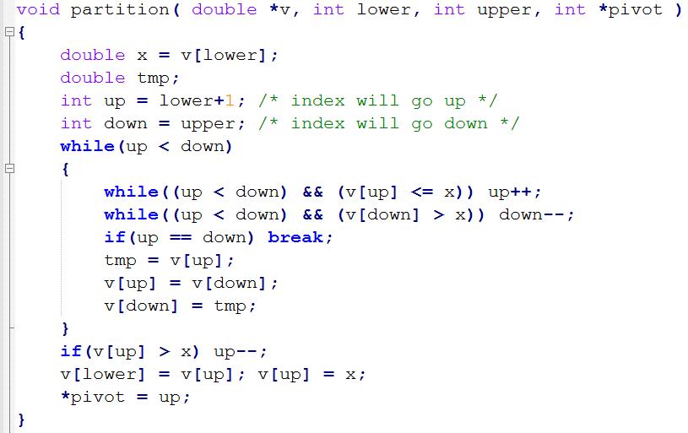
Partition function

Slide 11
Example of partition
Given a sequence: 4 6 2 5 3 7 1
First pass: 4 1 2 5 3 7 6
Second: 4 1 2 3 5 7 6
Final pass: 3 1 2 4 5 7 6
Pivot = 3

Slide 12
Partition and qsort in main()
int lower = 0;
int upper = n-1;
int pivot = 0;
if(n > 1) partition(v,lower,upper,&pivot);
if(pivot != 0)
qsort((void*)v,(size_t)pivot, sizeof(double),compare);
if(pivot != n)
qsort((void*)&v[pivot+1],(size_t)(n-pivot-1), sizeof(double),compare);

Slide 13
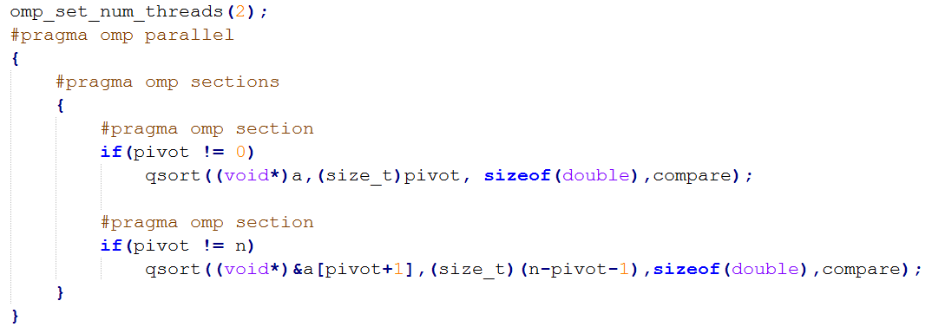
Qsort with OpenMP
a parallel region in main()

Slide 14
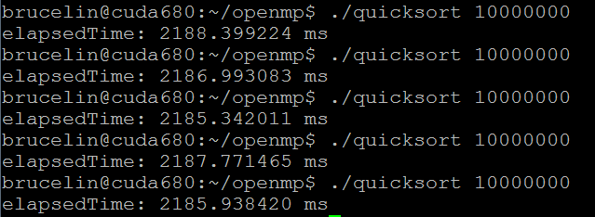
Timing
Single thread

Slide 15
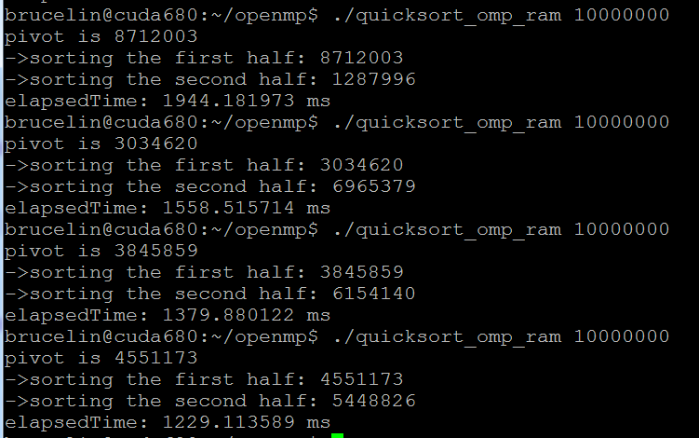
Effect of Load imbalance
2 threads: performance is variant because of load imbalance

Slide 16
Recommended reading
Edgar Solomonik and Laxmikant V. Kale: Highly Scalable Parallel Sorting. In the proceedings of the IEEE International Parallel and Distributed Processing Symposium (IPDPS), 2010.
Davide Pasetto and Albert Akhriev: A Comparative Study of Parallel Sort Algorithms. In SPLASH’11, the proceedings of the ACM international conference companion on object oriented programming systems languages and applications, pages 203-204, ACM 2011.
Mirko Rahn, Peter Sanders, and Johannes Singler: Scalable Distributed-Memory External Sorting. In the proceedings of the 26th IEEE International Conference on Data Engineering (ICDE), pages 685-688, IEEE, 2010.

